Slide 1
Sorting refers to rearrangement of a given array or list of elements according to a comparison operator on the elements. The comparison operator is used to decide the new order of elements in the respective data structure.

Slide 2
Sorting Basics
In-place Sorting: An in-place sorting algorithm uses constant space for producing the output (modifies the given array only. Examples: Selection Sort, Bubble Sort, Insertion Sort and Heap Sort.
Internal Sorting: Internal Sorting is when all the data is placed in the main memory or internal memory. In internal sorting, the problem cannot take input beyond allocated memory size.

Slide 3
External Sorting : External Sorting is when all the data that needs to be sorted need not to be placed in memory at a time, the sorting is called external sorting. External Sorting is used for the massive amount of data. For example Merge sort can be used in external sorting as the whole array does not have to be present all the time in memory,
Stable sorting: When two same items appear in the same order in sorted data as in the original array called stable sort. Examples: Merge Sort, Insertion Sort, Bubble Sort.
Hybrid Sorting: A sorting algorithm is called Hybrid if it uses more than one standard sorting algorithms to sort the array. The idea is to take advantages of multiple sorting algorithms. For example IntroSort uses Insertions sort and Quick Sort.

Slide 4
Types of Sorting Techniques
There are various sorting algorithms are used in data structures. The following two types of sorting algorithms can be broadly classified:
Comparison-based: We compare the elements in a comparison-based sorting algorithm)
Non-comparison-based: We do not compare the elements in a non-comparison-based sorting algorithm)

Slide 5
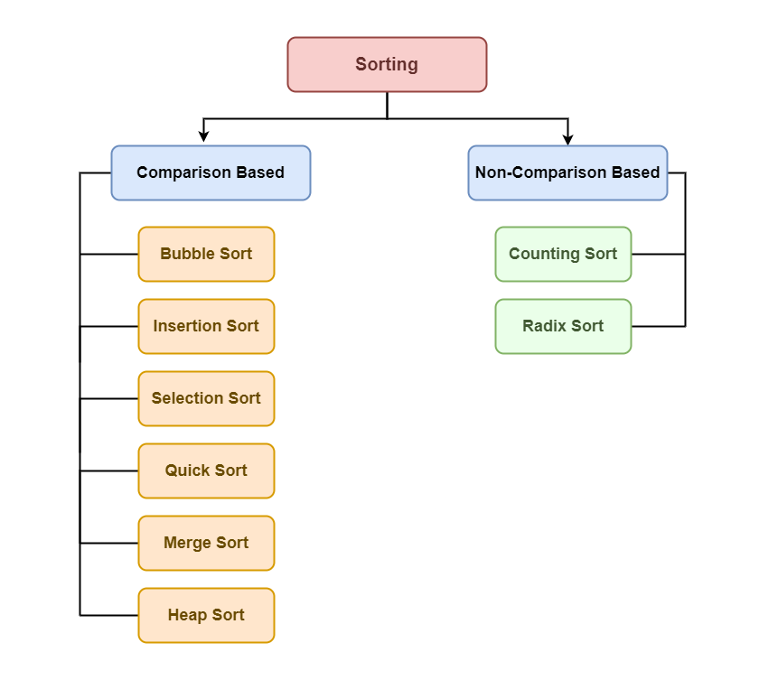

Slide 6
Some of the most common sorting algorithms are:
Selection sort
Bubble sort
Insertion Sort
Cycle Sort
Merge Sort
Quick sort
Heap sort
Counting sort

Slide 7
Selection Sort
Selection Sort is a comparison-based sorting algorithm. It sorts an array by repeatedly selecting the smallest (or largest) element from the unsorted portion and swapping it with the first unsorted element. This process continues until the entire array is sorted.

Slide 8
First we find the smallest element and swap it with the first element. This way we get the smallest element at its correct position.
Then we find the smallest among remaining elements (or second smallest) and move it to its correct position by swapping.
We keep doing this until we get all elements moved to correct position.

Slide 9
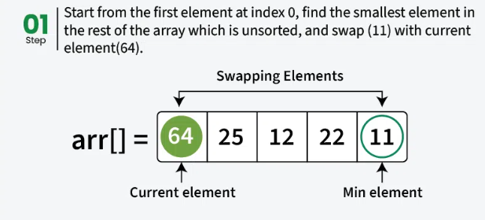

Slide 10
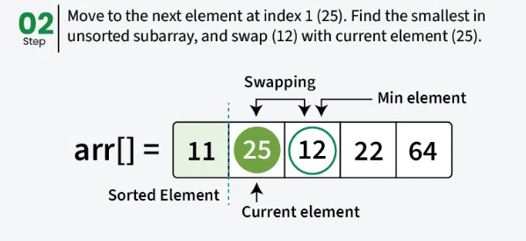

Slide 11
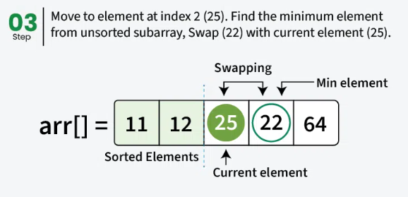

Slide 12
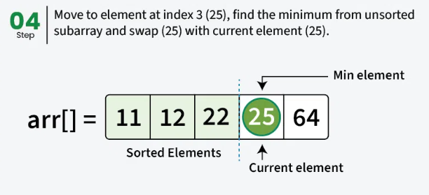

Slide 13
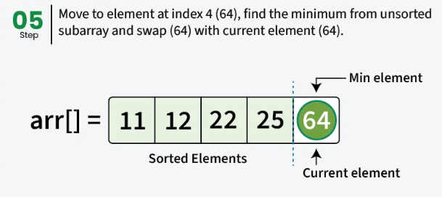

Slide 14
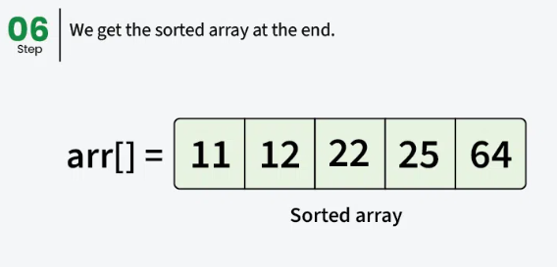

Slide 15
Algorithm of Selection Sort
Step 1 − Set MIN to location 0 Step 2 − Search the minimum element in the list Step 3 − Swap with value at location MIN Step 4 − Increment MIN to point to next element Step 5 − Repeat until list is sorted

Slide 16
Selection Sort Working Principle:
Initialization: Start with the first element as the current “minimum” (initially assuming it’s the smallest).
Search for Minimum: Iterate through the remaining unsorted elements, comparing each one with the current “minimum.” If you find a smaller element, update the current “minimum.”
Swap: After completing the iteration and finding the actual minimum among the unsorted elements, swap it with the first unsorted element (the one you started with).
Repeat: Repeat steps 1-3 for the next unsorted element, then the next, until the entire array is sorted.

Slide 17
Complexity Analysis of Selection Sort
Time Complexity: O(n²)
Auxiliary Space: O(1)
Advantages of Selection Sort
*Easy to understand and implement, making it ideal for teaching basic sorting concepts.
*Requires only a constant O(1) extra memory space.
*It requires less number of swaps (or memory writes) compared to many other standard algorithms. Therefore it can be simple algorithm choice when memory writes are costly.

Slide 18
Disadvantages of the Selection Sort
Selection sort has a time complexity of O(n^2) makes it slower compared to algorithms like Quick Sort or Merge Sort.
Does not maintain the relative order of equal elements.
Does not preserve the relative order of items with equal keys which means it is not stable.

Slide 19
Applications of Selection Sort
Perfect for teaching fundamental sorting mechanisms and algorithm design.
Suitable for small lists where the overhead of more complex algorithms isn’t justified.
Ideal for systems with limited memory due to its in-place sorting capability.
Used in simple embedded systems where resource availability is limited and simplicity is important.

Slide 20
Bubble Sort
Bubble Sort is the simplest sorting algorithm that works by repeatedly swapping the adjacent elements if they are in the wrong order.
This algorithm is not suitable for large data sets as its average and worst-case time complexity are quite high.

Slide 21
We sort the array using multiple passes. After the first pass, the maximum element goes to end (its correct position). Same way, after second pass, the second largest element goes to second last position and so on.
In every pass, we process only those elements that have already not moved to correct position. After k passes, the largest k elements must have been moved to the last k positions.
In a pass, we consider remaining elements and compare all adjacent and swap if larger element is before a smaller element. If we keep doing this, we get the largest (among the remaining elements) at its correct position.

Slide 22
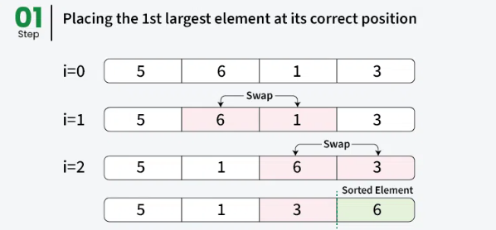
How does Bubble Sort Work?

Slide 23
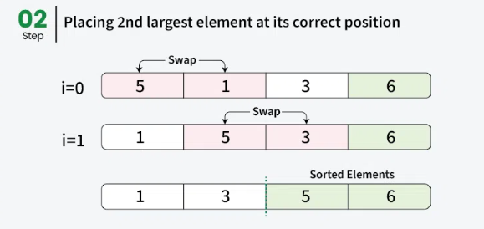

Slide 24
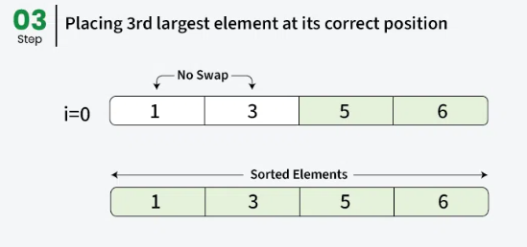

Slide 25
Complexity Analysis of Bubble Sort:
Time Complexity: O(n²) Auxiliary Space: O(1)
Advantages of Bubble Sort:
Bubble sort is easy to understand and implement.
It does not require any additional memory space.
It is a stable sorting algorithm, meaning that elements with the same key value maintain their relative order in the sorted output.

Slide 26
Disadvantages of Bubble Sort:
Bubble sort has a time complexity of O(n²) which makes it very slow for large data sets.
Bubble sort is a comparison-based sorting algorithm, which means that it requires a comparison operator to determine the relative order of elements in the input data set. It can limit the efficiency of the algorithm in certain cases.

Slide 27
Bubble Sort Algorithm
We assume list is an array of n elements. We further assume that swap function swaps the values of the given array elements.
Step 1 − Check if the first element in the input array is greater than the next element in the array.
Step 2 − If it is greater, swap the two elements; otherwise move the pointer forward in the array.
Step 3 − Repeat Step 2 until we reach the end of the array.
Step 4 − Check if the elements are sorted; if not, repeat the same process (Step 1 to Step 3) from the last element of the array to the first.
Step 5 − The final output achieved is the sorted array.

Slide 28
Insertion Sort
Insertion sort is a simple sorting algorithm that works by iteratively inserting each element of an unsorted list into its correct position in a sorted portion of the list. It is like sorting playing cards in your hands. You split the cards into two groups: the sorted cards and the unsorted cards. Then, you pick a card from the unsorted group and put it in the right place in the sorted group.

Slide 29
We start with second element of the array as first element in the array is assumed to be sorted.
Compare second element with the first element and check if the second element is smaller then swap them.
Move to the third element and compare it with the first two elements and put at its correct position
Repeat until the entire array is sorted.

Slide 30
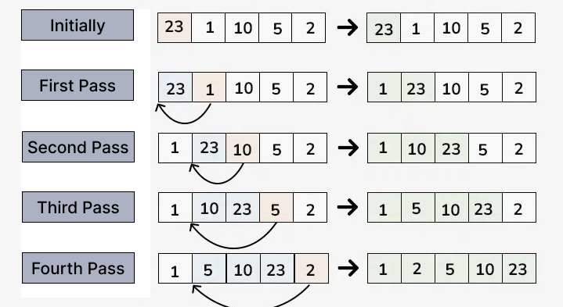

Slide 31
Time Complexity of Insertion Sort
Best case: O(n) , If the list is already sorted, where n is the number of elements in the list.
Average case: O(n ² ) , If the list is randomly ordered
Worst case: O(n ² ) , If the list is in reverse order
Space Complexity of Insertion Sort
Auxiliary Space: O(1), Insertion sort requires O(1) additional space, making it a space-efficient sorting algorithm.

Slide 32
Advantages of Insertion Sort:
Simple and easy to implement.
Stable sorting algorithm.
Efficient for small lists and nearly sorted lists.
Space-efficient as it is an in-place algorithm.
Adoptive. the number of inversions is directly proportional to number of swaps. For example, no swapping happens for a sorted array and it takes O(n) time only.
Disadvantages of Insertion Sort:
Inefficient for large lists.
Not as efficient as other sorting algorithms (e.g., merge sort, quick sort) for most cases.

Slide 33
Applications of Insertion Sort:
Insertion sort is commonly used in situations where:
The list is small or nearly sorted.
Simplicity and stability are important.
Used as a subroutine in Bucket Sort
Can be useful when array is already almost sorted (very few inversions)
Since Insertion sort is suitable for small sized arrays, it is used in Hybrid Sorting algorithms along with other efficient algorithms like Quick Sort and Merge Sort. When the subarray size becomes small, we switch to insertion sort in these recursive algorithms. For example IntroSort and TimSort use insertions sort.

Slide 34
Quick Sort
QuickSort is a sorting algorithm based on the Divide and Conquer(breaking down the problem into smaller sub-problems) that picks an element as a pivot and partitions the given array around the picked pivot by placing the pivot in its correct position in the sorted array.

Slide 35
How does QuickSort Algorithm work?
There are mainly three steps in the algorithm:
Choose a Pivot: Select an element from the array as the pivot. The choice of pivot can vary (e.g., first element, last element, random element, or median).
Partition the Array: Rearrange the array around the pivot. After partitioning, all elements smaller than the pivot will be on its left, and all elements greater than the pivot will be on its right. The pivot is then in its correct position, and we obtain the index of the pivot.
Recursively Call: Recursively apply the same process to the two partitioned sub-arrays (left and right of the pivot).
Base Case: The recursion stops when there is only one element left in the sub-array, as a single element is already sorted.

Slide 36
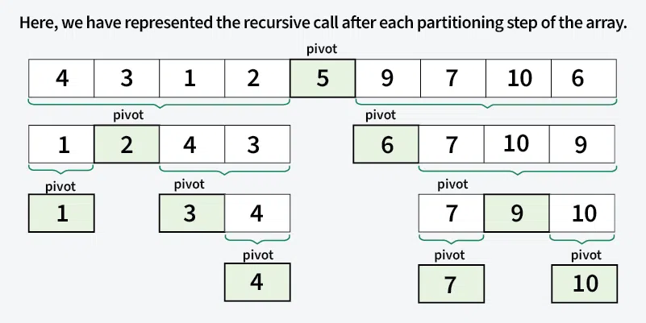

Slide 37
Complexity Analysis of Quick Sort
Time Complexity:
Best Case: (Ω(n log n)), Occurs when the pivot element divides the array into two equal halves.
Average Case (θ(n log n)), On average, the pivot divides the array into two parts, but not necessarily equal.
Worst Case: (O(n²)), Occurs when the smallest or largest element is always chosen as the pivot (e.g., sorted arrays).
Auxiliary Space: O(n), due to recursive call stack

Slide 38
Advantages of Quick Sort
It is a divide-and-conquer algorithm that makes it easier to solve problems.
It is efficient on large data sets.
It has a low overhead, as it only requires a small amount of memory to function.
It is Cache Friendly as we work on the same array to sort and do not copy data to any auxiliary array.
Fastest general purpose algorithm for large data when stability is not required.
It is tail recursive and hence all the tail call optimization can be done.

Slide 39
Disadvantages of Quick Sort
It has a worst-case time complexity of O(n²), which occurs when the pivot is chosen poorly.
It is not a good choice for small data sets.
It is not a stable sort, meaning that if two elements have the same key, their relative order will not be preserved in the sorted output in case of quick sort, because here we are swapping elements according to the pivot’s position (without considering their original positions).

Slide 40
Merge Sort
Merge sort is a sorting algorithm that follows the divide-and-conquer approach. It works by recursively dividing the input array into smaller subarrays and sorting those subarrays then merging them back together to obtain the sorted array.
In simple terms, we can say that the process of merge sort is to divide the array into two halves, sort each half, and then merge the sorted halves back together. This process is repeated until the entire array is sorted.

Slide 42
Here’s a step-by-step explanation of how merge sort works:
Divide: Divide the list or array recursively into two halves until it can no more be divided.
Conquer: Each subarray is sorted individually using the merge sort algorithm.
Merge: The sorted subarrays are merged back together in sorted order. The process continues until all elements from both subarrays have been merged.

Slide 43
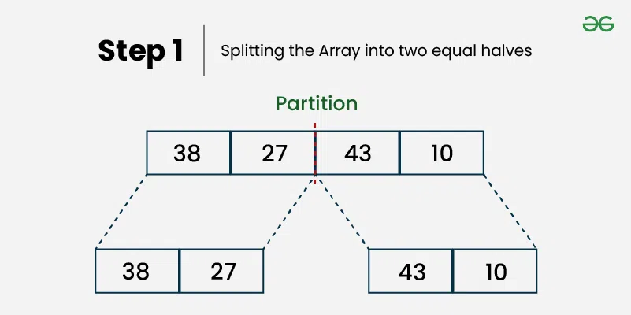
Illustration of Merge Sort: Let’s sort the array or list [38, 27, 43, 10] using Merge Sort

Slide 44
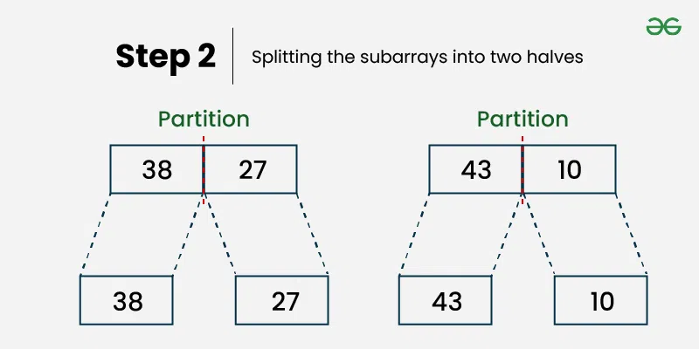
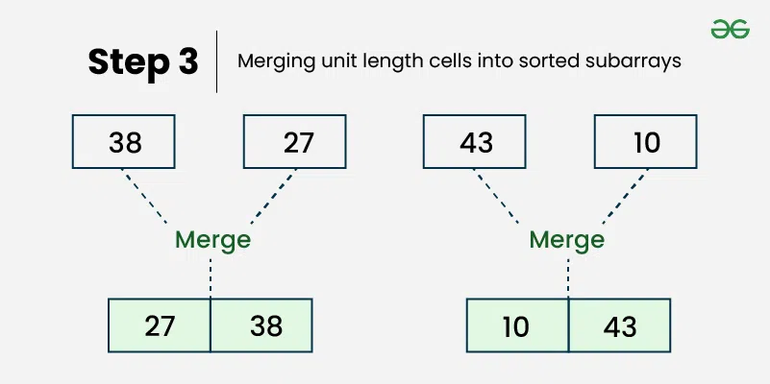

Slide 45
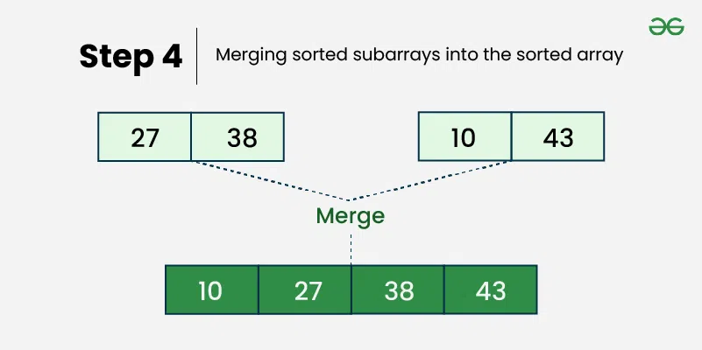

Slide 46
Complexity Analysis of Merge Sort:
Time Complexity:
Best Case: O(n log n), When the array is already sorted or nearly sorted.
Average Case: O(n log n), When the array is randomly ordered.
Worst Case: O(n log n), When the array is sorted in reverse order.
Auxiliary Space: O(n), Additional space is required for the temporary array used during merging.

Slide 47
Applications of Merge Sort:
Sorting large datasets
External sorting (when the dataset is too large to fit in memory)
Inversion counting
Merge Sort and its variations are used in library methods of programming languages. For example its variation TimSort is used in Python, Java Android and Swift. The main reason why it is preferred to sort non-primitive types is stability which is not there in QuickSort. For example Arrays.sort in Java uses QuickSort while Collections.sort uses MergeSort.
It is a preferred algorithm for sorting Linked lists.
It can be easily parallelized as we can independently sort subarrays and then merge.
The merge function of merge sort to efficiently solve the problems like union and intersection of two sorted arrays.

Slide 48
Advantages of Merge Sort:
Stability : Merge sort is a stable sorting algorithm, which means it maintains the relative order of equal elements in the input array.
Guaranteed worst-case performance: Merge sort has a worst-case time complexity of O(N logN) , which means it performs well even on large datasets.
Simple to implement: The divide-and-conquer approach is straightforward.
Naturally Parallel : We independently merge subarrays that makes it suitable for parallel processing.

Slide 49
Disadvantages of Merge Sort:
Space complexity: Merge sort requires additional memory to store the merged sub-arrays during the sorting process.
Not in-place: Merge sort is not an in-place sorting algorithm, which means it requires additional memory to store the sorted data. This can be a disadvantage in applications where memory usage is a concern.
Slower than QuickSort in general. QuickSort is more cache friendly because it works in-place.

Slide 50
